Slide 1

Semantic Tags & Why You Should Use Them!

Slide 2
Much of the benefits from HTML5 has mostly been for shiny new APIs
Local Storage
Web Workers
Application Cache
Vibration / Battery API
But let’s not overlook that HTML5 brought us 30 new elements to mark up our websites with!

Slide 3
Semantics refers to the correct interpretation of the meaning of a word or sentence. To use a word semantically is to use it in a way that is properly aligned with the meaning of the word.

Slide 4
A semantic element clearly describes its meaning to both the browser and the developer.

Slide 5
Tags are no longer just a way to get content to show up on a web page in a human-readable format.
The tags themselves have become a way to tell a machine something about the meaning of the content.

Slide 6
Some presentational tags are gone!
1

Slide 7
Purely presentational tags such as
`center`, `font` and `big` are obsolete.
Their role as been adequately replaced by Cascading Style Sheets.

Slide 8
Some tags have changed their job into a more semantic role.
The `small` tag no longer means “small font” but now its meaning is “side comment”*.
*Side Comments are generally used for disclaimers, caveats, copyrights, etc.

Slide 9
What’s new, then?
2

Slide 10
<article> | Defines an article in a document
<aside> | Defines content aside from the page content
<details> | Defines additional details that the user can view or hide
<figure> | Defines self-contained content
<figcaption> | Defines a caption for a <figure> element

Slide 11
<header> | Defines a header for a document or section
<footer> | Defines a footer for a document or section
<main> | Defines the main content of a document
<nav> | Defines navigation links
<section> | Defines a section in a document

Slide 12
Very exciting list, you have there!
Z
Z
Z
Show us some us some real world usage…

Slide 13
Why is Semantic Markup important?
3

Slide 14
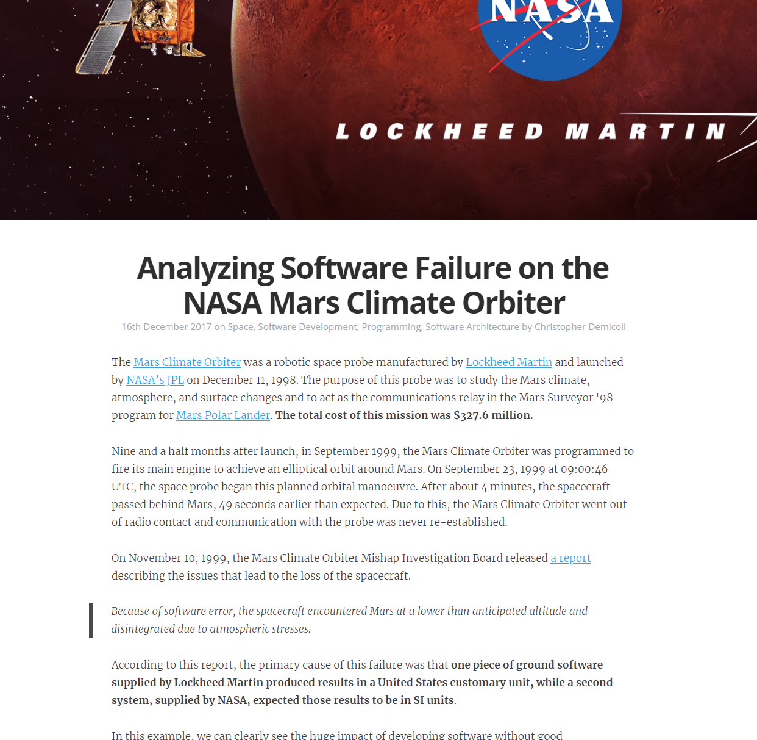
Can you spot the article on this page?

Slide 15
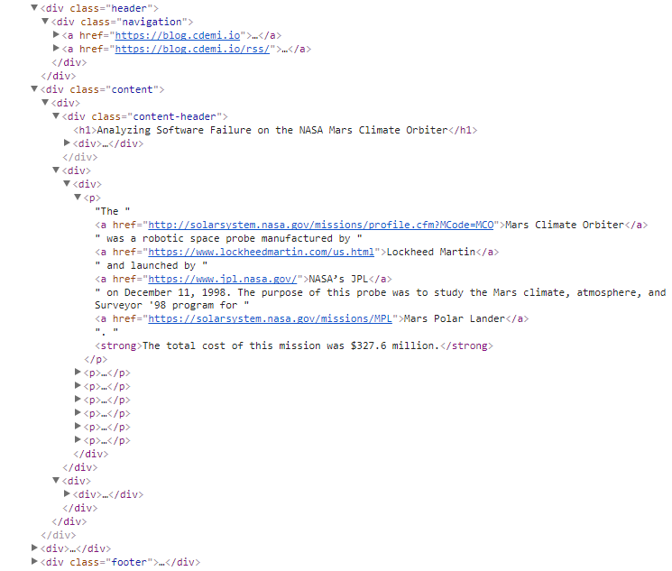
How about within its markup?

Slide 16
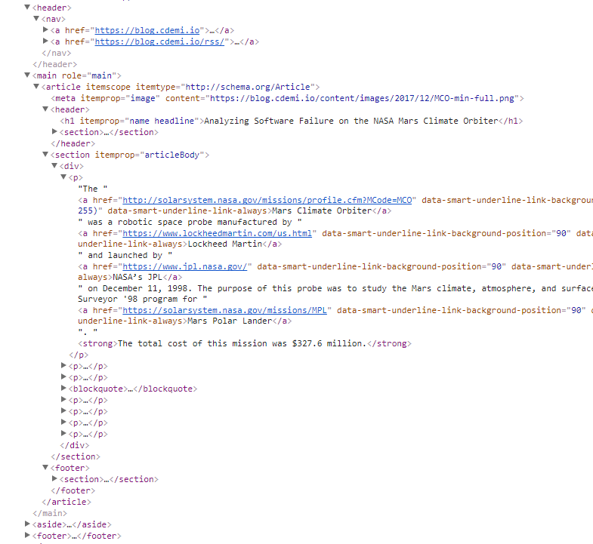
How about its shiny new HTML5 markup?

Slide 17
Good CSS can make bad markup invisible to the average website visitor. However, no amount of styling will make bad markup more meaningful to a computerized visitor ...

Slide 18
What’s in it for me, though?
Better search engine rankings
Contributing to a more accessible web
Future proofing you code
Meaning of content is no longer inferred but instead defined
Using the right tools for the job!

Slide 19
Thanks!
Any questions?

Slide 20
Sources
https://html.com/semantic-markup/
https://www.smashingmagazine.com/2011/11/html5-semantics/
https://www.w3schools.com/html/html5_semantic_elements.asp
https://www.w3.org/TR/html5-diff/#changed-elements

